Slide 1
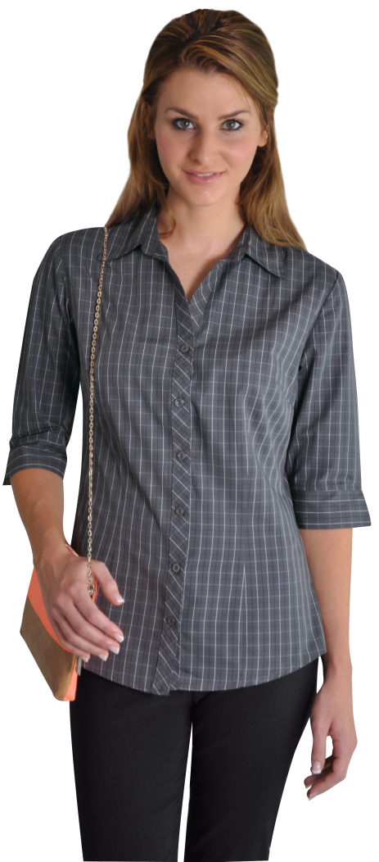
MOTOR INDUSTRY UNIFORMS

